Slide 1

Digit Handwritten Prediction Using Tensorflow Lite Micro on ESP32-S3
22/495313/PTK/14431
Muhammad Rizqi Subeno

Slide 2
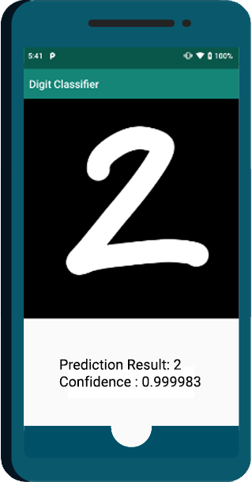
Digit Handwritten Prediction Using Tensorflow Lite Micro
Handwritten digit recognition is the process to provide the ability to machines to recognize human handwritten digits. It is not an easy task for the machine because handwritten digits are not perfect, vary from person-to-person, and can be made with many different flavors. Handwritten digit recognition nowaday using Neural Network that can predict the digit with confidence up to 99%.

Slide 3
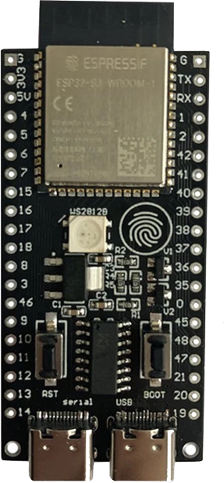

Why, choose this project ? Why Use ESP32S3 ?
How to implement Neural Network on microcontroller ?
How fast Neural Network can be use on realtime application ?
As on website, they claim to have support for artificial intelligence
“ESP32-S3 has additional support for vector instructions in the MCU, which provides acceleration for neural network computing and signal processing workloads. Developers can take advantage of these vector instructions through ESP-DSP and ESP-NN libraries to optimize their applications”.

Slide 4

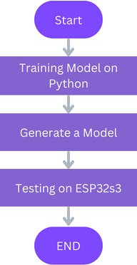
So How to Build ?
Prepare the Hardware Layout / Schematic, Build the hardware and Design the flowchart.
flowchart application
2. Design the LVGL Layout (using SquareLine Studio) and then let’s create the code. (Note : Don’t forget to create neural network model from tensorflow on python)

Slide 5
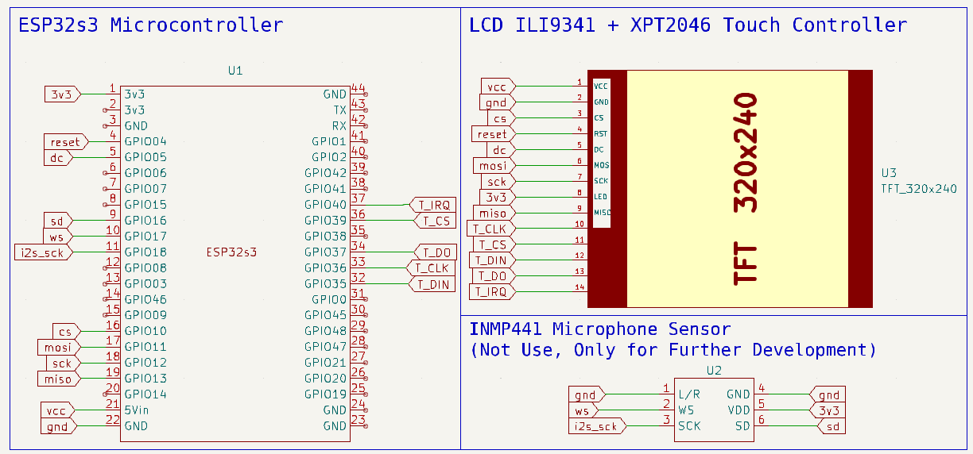
Schematic Layout
Kicad Schematic Design

Slide 6

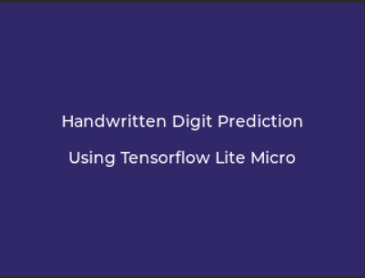
LVGL Screen Title
First time microcontroller running, the above screen will appear
- The component for this title screen :
1. Label (LV_LABEL)
2. Image (LV_IMAGE)
3. Panel (LV_PANEL)
Have animations

Slide 7
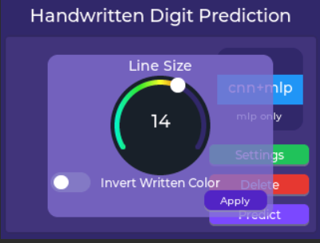
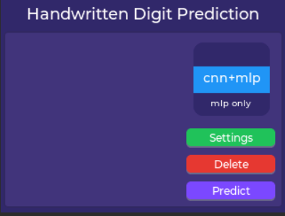
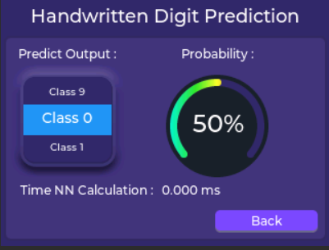
LVGL Main Screen
Settings pressed
Predict pressed
After title screen appear, the Main Screen appear then delete the title screen. When settings button pressed, settings panel will appear. When Predict button pressed, Predict panel will appear. (Note : all panels are still in one screen )

Slide 8
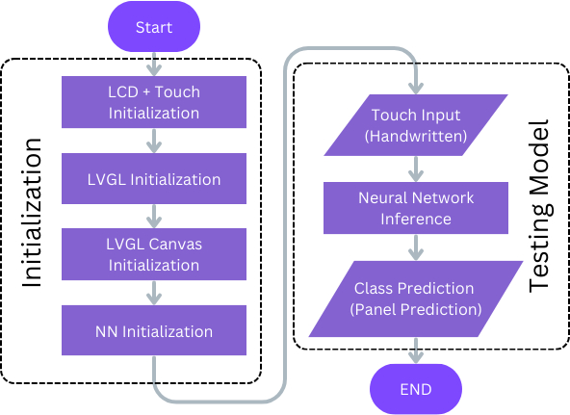
Application Flow Diagram
Diagram disamping merupakan alur kerja pada program yang dibuat pada mikrokontroler ESP32s3 dengan menggunakan ESP-IDF. Pada bagian awal program dijalankan, proses inisiasi dijalankan mulai dari inisiasi driver LCD+Touch lalu inisiasi LVGL, komponen-komponen LVGL seperti (button, label dan canvas), Inisiasi model neural network. Lalu pada bagian selanjutnya adalah Proses pengujian model (Inferencing Model) dengan memasukkan input ke dalam model yang telah di-inisiasi lalu mengambil keluaran kelas untuk mengetahui hasilnya.

Slide 9
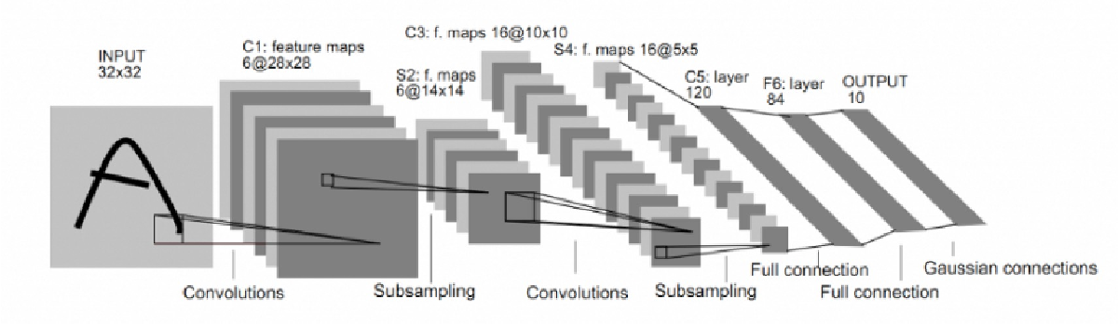
Proposed Neural Network
Softmax
Neural Network proposed model (CNN+MLP Model)
MLP Only Model
CNN+MLP Model using Convolutional for feature extraction to get spatial feature of image then reshape the feature to enter the Fully Connected Layer. For MLP Only Model, the input of image directly reshape to a vector then feeding to Fully Connected Layer.

Slide 10


Source Code
+
code with espressif-IDF
for training a neural network with jupyter lab
link : https://github.com/rizqisubeno/esp32s3_handwritten_recognition
link : https://github.com/rizqisubeno/esp32s3_handwritten_recognition/blob/main/mnist_train.ipynb

Slide 11

That is the end of the presentation. Thank you.

